Slide 1




Metro Case Study
Consumers pricing perception
And it also saves your money!

Slide 2

Executive Summary
Research Objectives
Introduction
Agenda
Problems
Industry Overview
SWOT Analysis
Price Perception
External Factors
Vivi Data Analysis
Promotional Strategies
Recommendations & Conclusion

Slide 3



Executive Summary
Our research goal is to explore how consumers perceive prices at Metro compared to Food Basics. Our approach will consist of the analysis of price perception patterns, assessing the impact of marketing strategies on consumer expectations, and taking into consideration diverse factors (ethnic, cultural, and demographic) influencing price perceptions and store choices.
The aftermath is to provide you insights to help Metro adapt strategies, meet the evolving consumer needs, and maintain satisfaction and loyalty in a constantly changing market.
Notes:
Goal xplore consimers price perception
As approach, We will be using the analysis of patterns and multiple factors such etchnic cultural demographic
We will be proving you with interesting insight and recommendations adapt strategies.

Slide 4







Research Objectives
01
02
03
04
Objective 01
Objective 02
Objective 03
Objective 04
Formulation of Price Perceptions: Understand how, when, and where consumers shape price perceptions across retail banners.
Strategies Driving Satisfaction: Identifying strategies creating favorable perceptions of price and value.
Impact of Advertising/Promotions: Examine how promotional strategies influence customer price expectations and store choices.
Influence of Demographic Factors: Investigate ethnic, cultural, demographic, and geographic factors affecting customer price expectations and store preferences.

Slide 5

Introduction
The grocery retail landscape in Canada is marked by dynamic shifts influenced by consumer trends, economic conditions, and technological advancements. Online shopping has seen a significant uptick, and consumers are increasingly health-conscious and environmentally aware. Despite technological efforts, the impact of food inflation persists, necessitating a closer examination of consumer perceptions of prices and value.

Slide 6




Problems
Metro.Inc faces challenges due to its:
Geographic concentration
Intense competition
Changing retail landscape
To address these challenges, we focussed on:
Understanding consumer perceptions of prices and value
Exploring factors influencing choices among retail banners

Slide 7
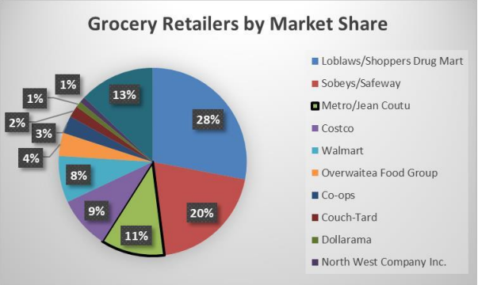
Industry Overview:
Financial Highlights (FY2023-28):
Current Market Size(2023): 116.1 Billion CAD
Projected CAGR: 0.6%
Expected Market Size(2028): 119.6 Billion CAD

Slide 8


METRO.INC
SWOT ANALYSIS
STRENGTH
WEEKNESS
Diverse Retail Store Network
Strong Financial Performance (FY2021: CAD 18,283M Revenue)
Focus on Quality (USDA Certified Organic)
Geographic Concentration in Canada
Vulnerability to Regional Economic and Climatic Factors
OPPURTUNITIES
THREATS
Exploiting Growing Online Retail Market in Canada
Store Expansion and Renovations for Growth
Intense Competition (Walmart, Costco)
Potential Customer Loss Due to Competitive Forces

Slide 9


Price Perception

Slide 10







Economic Drivers of Customer Behavior and Price Perception Shifts
Supply chain disruption
The rise of gas price
Pandemic
Inflation Rate Increase
Ukraine-Russia war

Slide 11





Market trends that influence the price perception?
Health and Wellness Trends
Sustainability and Ethical
Consumption
Convenience and Time-Saving Products

Slide 12




The factors that affects Consumers’ Trust
False Advertising
Shrinkflation
Lack of CSR

Slide 13





The factors that affects Consumers’ Trust
Local Sourcing
Certifications and Awards
Quality Guarantees

Slide 14

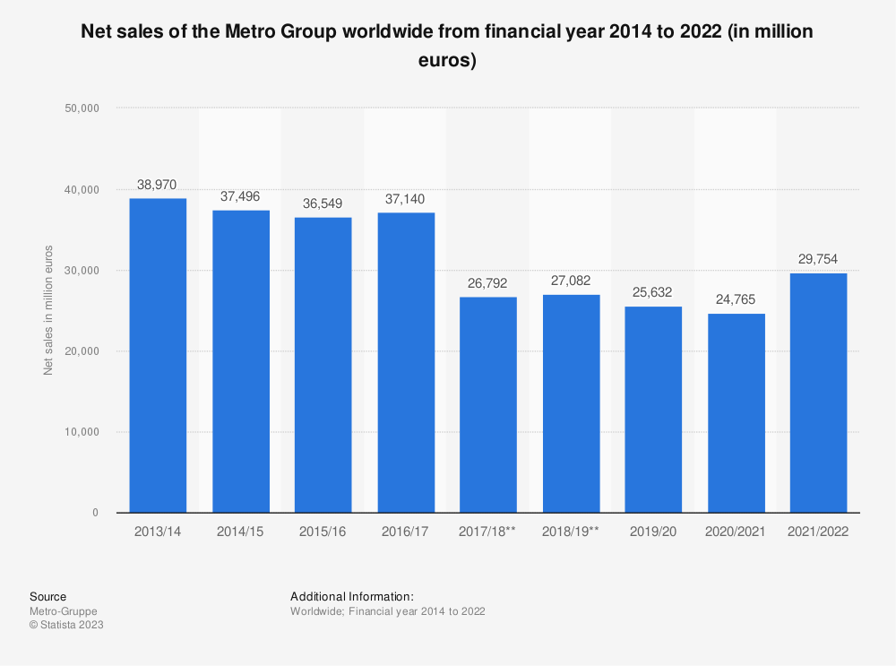

Net
Sales
Notes:
Costco has become a central retail hub for consumers aged 35-49, while Walmart has demonstrated dominance in both the 18-34 and the 35-49 age demographics. In contrast, Metro has established a strong foothold among consumers aged 50-64 and those aged 65 and above. Concurrently, renowned retailers such as Safeway and IGA have successfully attracted customers across diverse age groups, positioning themselves as preferred choices for consumers spanning various demographics.

Slide 15
External Factors

Slide 16
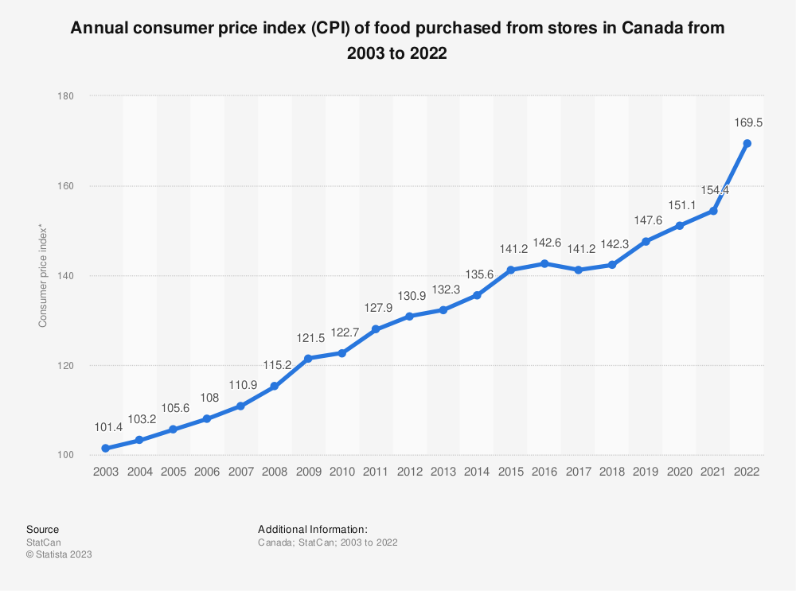
CPI
Notes:
The Consumer Price Index (CPI) measures changes in the average prices of goods and services. For companies like Metro Inc:
Costs: CPI affects the cost of goods and operating expenses.
Pricing: Inflation influences pricing strategies and profit margins.
Consumer Behavior: Changes in CPI impact consumer spending patterns.

Slide 17
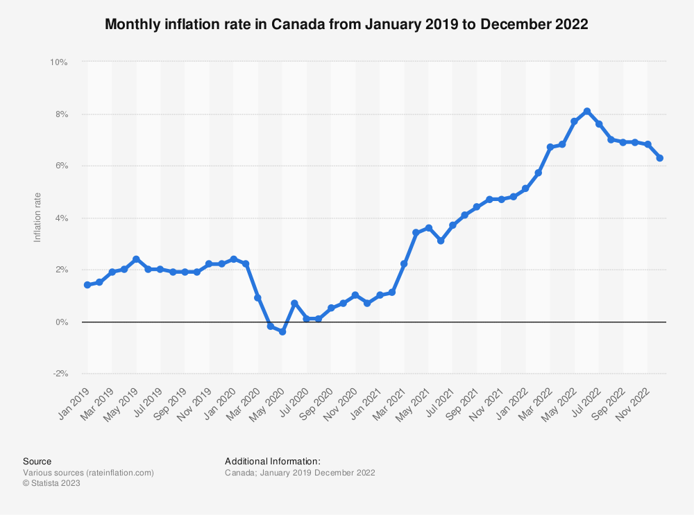
Inflation
Notes:
If the CPI is rising, it If CPI is rising it suggests inflationary pressures in the economy. Inflation can lead to an increase in the cost of goods and services for businesses. Metro Inc, as a retailer, may face higher costs for inventory, transportation, and other operational expenses. This could potentially lead to higher prices for consumers.
Consumer perception of prices is influenced by their expectations and experiences. If the CPI indicates rising prices in general, consumers may expect prices at Metro Inc and other retailers to increase as well. This expectation can influence their perception of the prices they encounter.

Slide 18
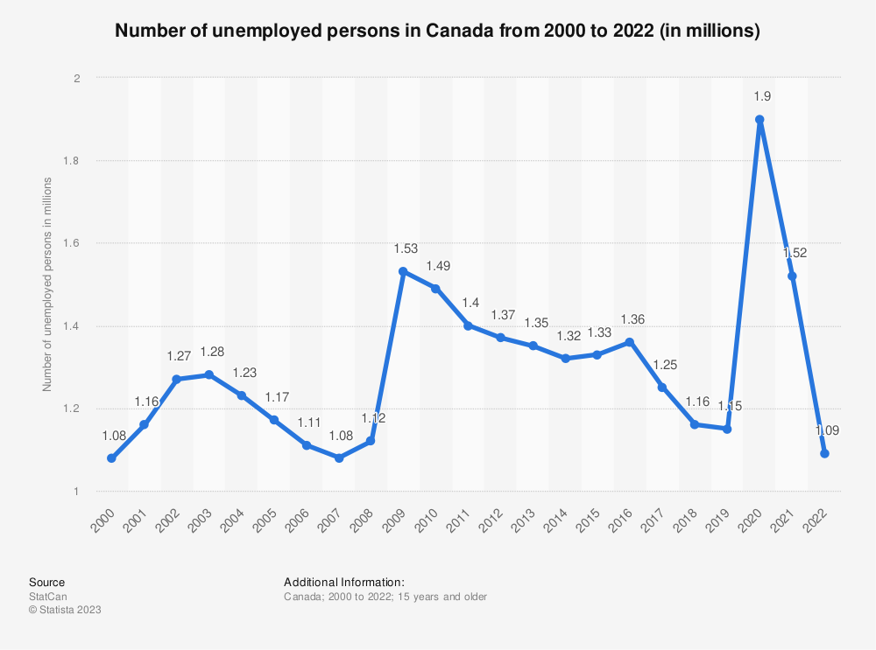
Unemployment

Slide 19
Vividata Analysis
Notes:
We have conducted Vividata Analysis for various demographics to support our research.

Slide 20
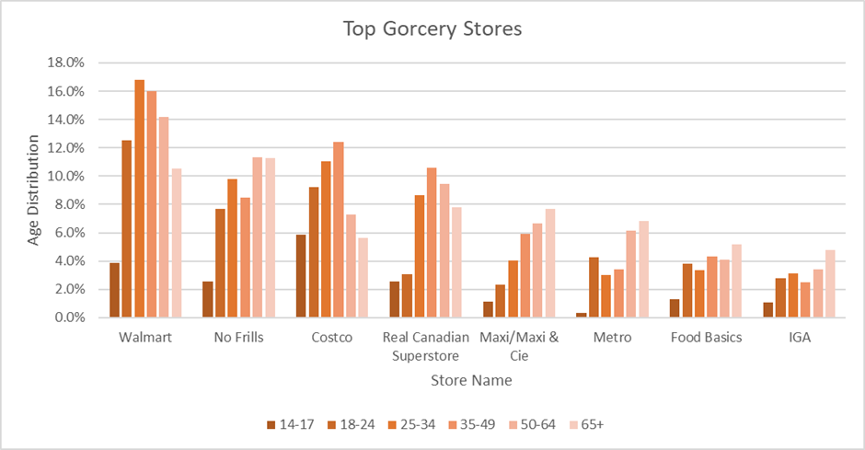
Age
Costo - 35 to 49
Walmart - 18 to 34 and 35 to 49
Metro - 50 to 64 and 65+
Notes:
The first one being Age
Costco has become a central retail hub for consumers aged 35-49, while Walmart has demonstrated dominance in both the 18-34 and the 35-49 age demographics. In contrast, Metro has established a strong foothold among consumers aged 50-64 and 65+. The age group of 14-17 is unexplored for Metro presently. Concurrently, renowned retailers such as Safeway and IGA have successfully attracted customers across diverse age groups.

Slide 21

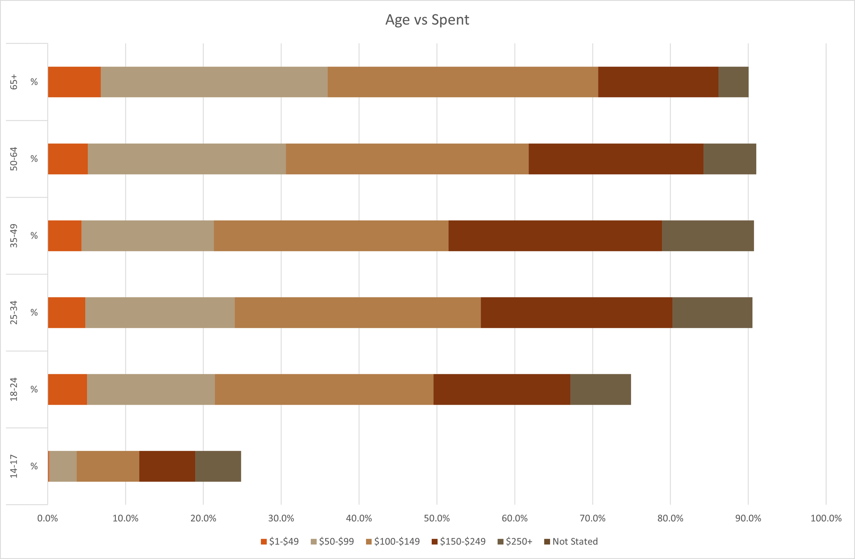

Age vs Spending
Elderly consumer groups tend to allocate more of their weekly expenditures.
Notes:
The analysis of spending patterns based on age groups reveals that older demographic segments exhibit higher weekly expenditure allocations. Consequently, stores frequented by a substantial number of older customers are likely to register elevated sales and profit figures, even if the overall customer count is comparatively lower.

Slide 22

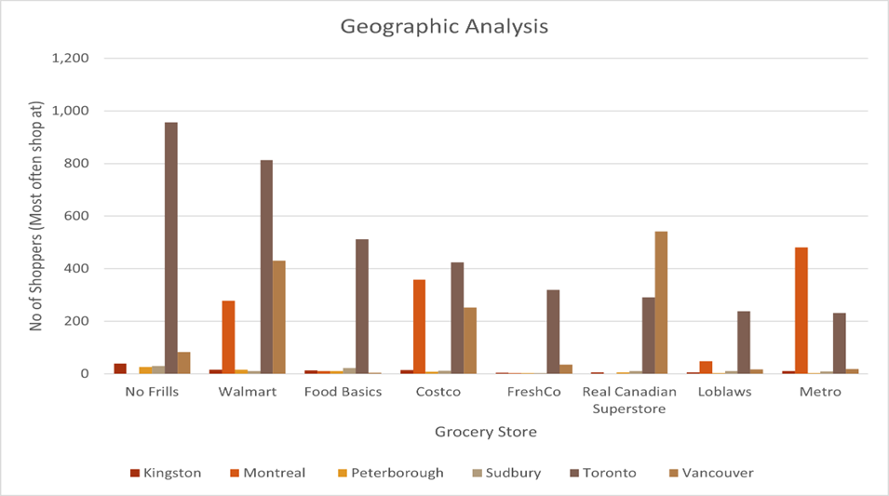

Toronto - No Frills and Walmart
Vancouver - Costco
Montreal - Metro
Kingston - No Frills
Location/Geographic
Notes:
Location or Geographic Analysis
In Toronto, the preferred retail choices for consumers are No Frills and Walmart, catering to the city's cost-conscious demographic. In Vancouver, the market is notably dominated by Costco, renowned for bulk-buying, surpassing the influence of Walmart. In the relatively smaller city of Kingston, No Frills emerges as the dominant player in the grocery market. Meanwhile, in Montreal, a culturally rich area, Metro is the favoured choice, owing to its diverse and international shopping experience.

Slide 23

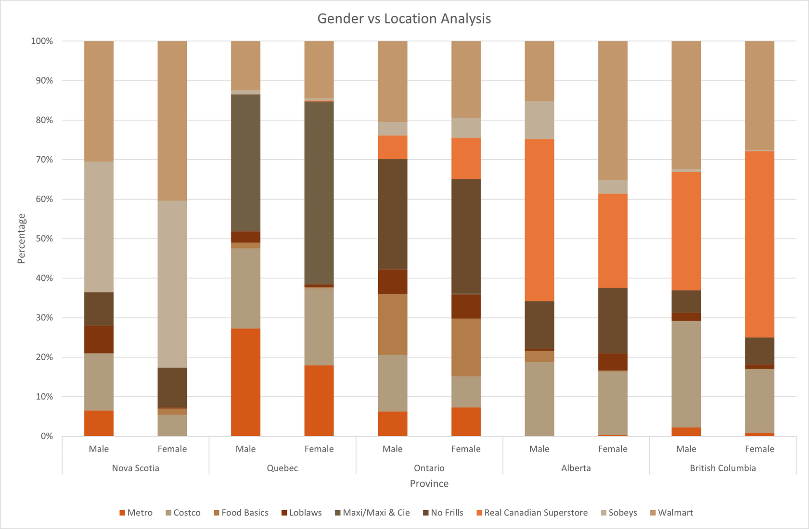
Gender vs Location
Maxi/Maxi & Cie in Quebec - significant gender disparieties
Costco - balanced gender distribution across various provinces
Food Basics in Ontario - higher percentage of female customers
Metro - varies across provinces - slight inclination towards males
Notes:
We have created a cross-tabulation between Gender and Location. It reveals that Maxi/Maxi & Cie in Quebec exhibits notable gender disparities among its customers, with female proportion being high. In contrast, Costco demonstrates a balanced gender distribution across various provinces, highlighting its broad appeal to both the genders. In Ontario, Food Basics emerges successful, with a higher percentage of female customers. Metro's gender distribution varies across provinces, presenting a nuanced picture of its customer base. However, there does some seem to be a slight inclination towards male shoppers.

Slide 24
Promotional
Strategies

Slide 25
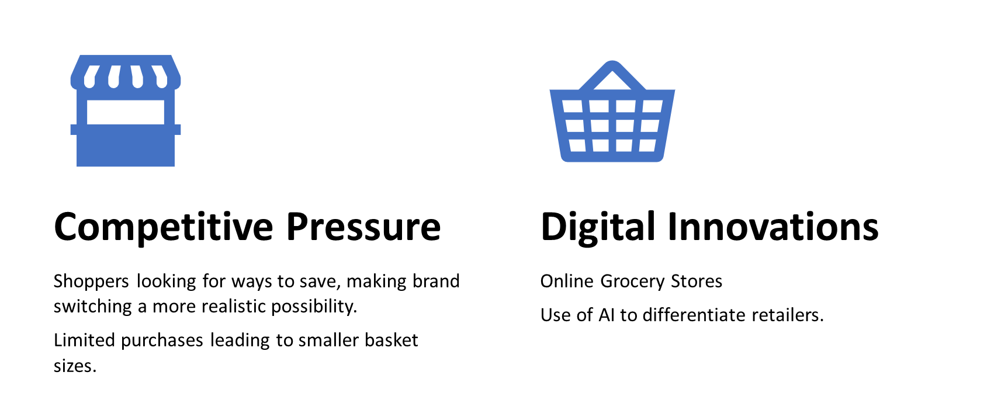
Outlook of Promotional Challenges by Metro
Notes:
Costco has become a central retail hub for consumers aged 35-49, while Walmart has demonstrated dominance in both the 18-34 and the 35-49 age demographics. In contrast, Metro has established a strong foothold among consumers aged 50-64 and those aged 65 and above. Concurrently, renowned retailers such as Safeway and IGA have successfully attracted customers across diverse age groups, positioning themselves as preferred choices for consumers spanning various demographics.

Slide 26
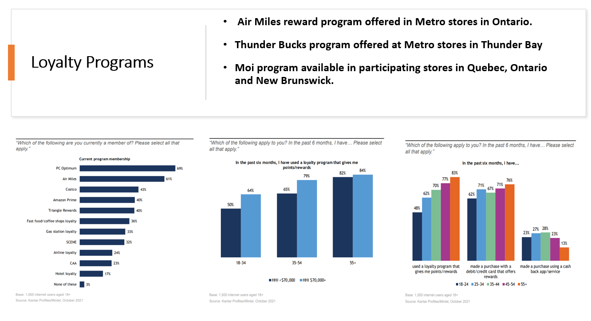

Slide 27

Innovative Approach : Metro Rewards Program
Notes:
Costco has become a central retail hub for consumers aged 35-49, while Walmart has demonstrated dominance in both the 18-34 and the 35-49 age demographics. In contrast, Metro has established a strong foothold among consumers aged 50-64 and those aged 65 and above. Concurrently, renowned retailers such as Safeway and IGA have successfully attracted customers across diverse age groups, positioning themselves as preferred choices for consumers spanning various demographics.

Slide 28
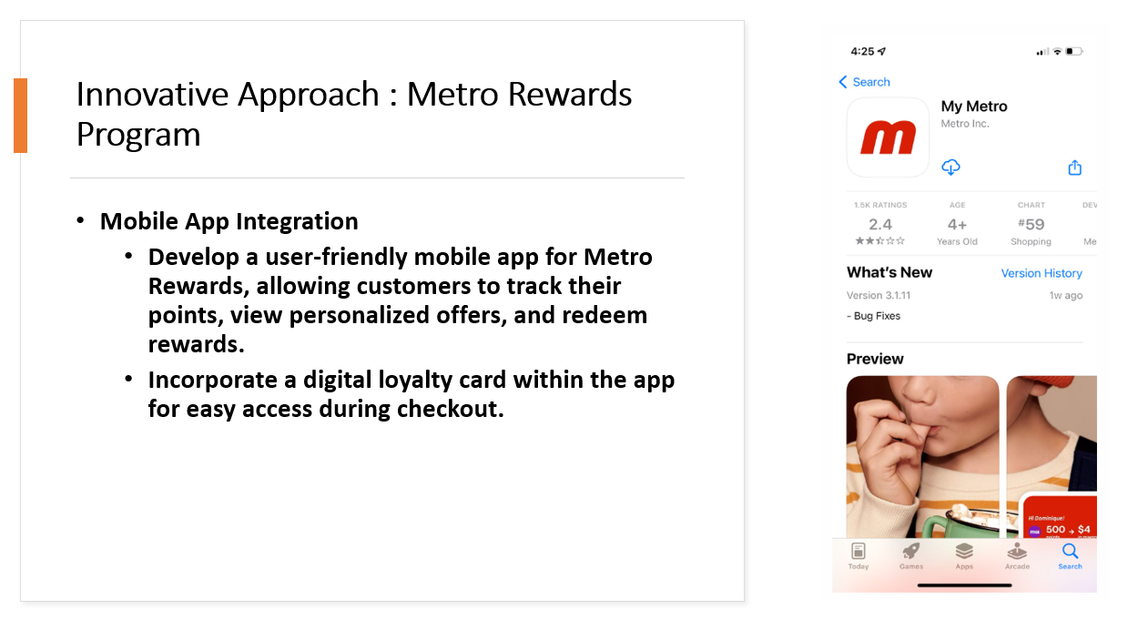

Slide 29
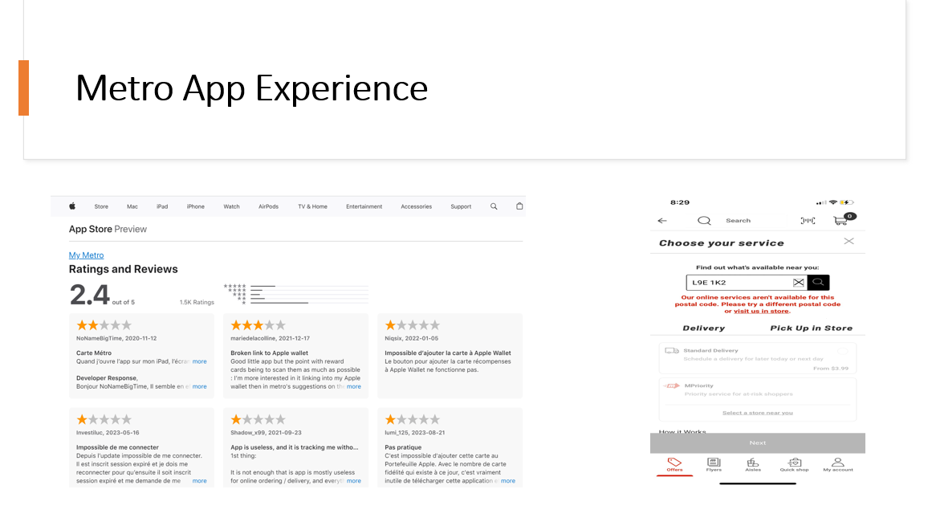

Slide 30
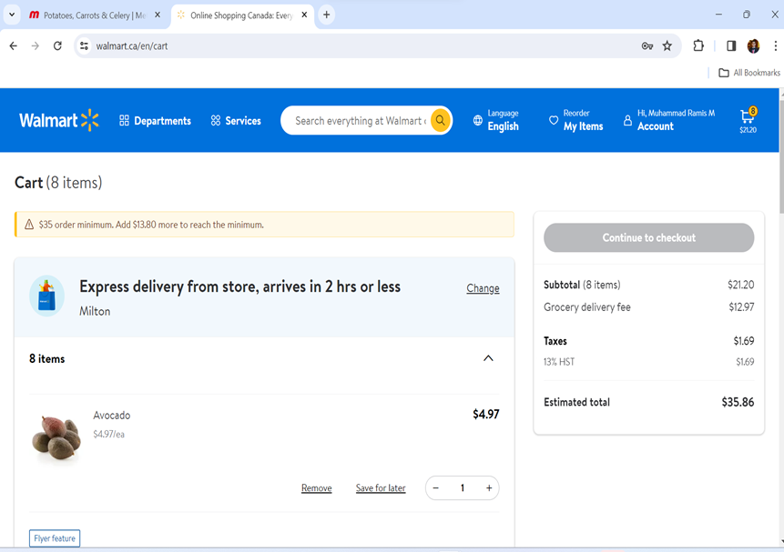
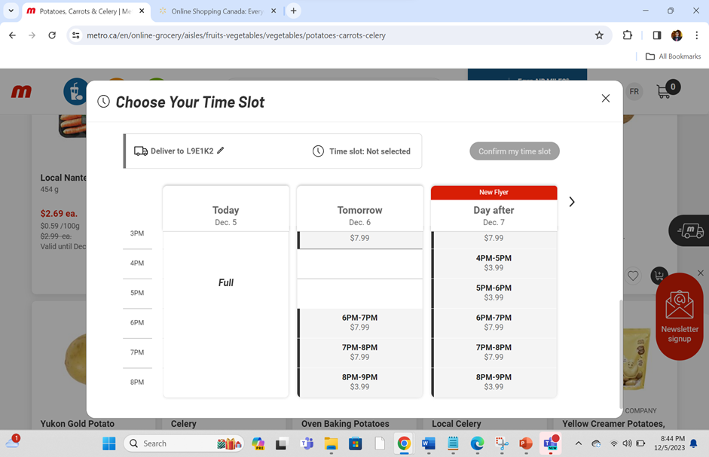
Customer Experience using website

Slide 31
RECOMMENDATIONS

Slide 32





Digital Marketing Focus
Tailored strategies
Targeting high income households
Loyalty program- App integrated
Cross-marketing opportunities
competitor analysis
Notes:
Digital marketing focus Targeting younger demographics via social media platforms with exclusive app features, discounts, and ads, capitalizing on their strong social media presence
Tailoring strategies to target younger segments involves leveraging digital platforms, engaging
content, and influencer partnerships.
Penetrating high-income households' entails introducing premium products, personalized
experiences, and exclusive loyalty tiers.
Loyalty programs, integrated within the app, rewarding frequent shoppers, and encouraging app downloads would also go a long way for enhancing the customer base.
Collaborations with local businesses and enhance cross-marketing opportunities. influencers, 2
Online shopping promotions tailored seasonal campaigns, and a commitment to sustainability
further enrich the consumer experience. In-store features, such as augmented reality and
location-based promotions, enhance the shopping experience
lastly
a robust competitor analysis, exploring positioning, pricing, and engagement strategies, would
inform strategic decision-making. Through continuous assessment and strategic adjustments,
Metro can aim to stay ahead in the dynamic re
Content marketing initiatives

Slide 33
CONCLUSION

Slide 34
This team effort research along with Vividata insights helped us dive into the competitive landscape of Metro and Food Basics in the Canadian grocery market, showcasing their unique strengths and appeal to distinct demographic segments.
Food Basics resonating among budget-conscious young consumers and Metro attracting young professionals and higher-educated individuals with greater income. The study's nuanced understanding of age-specific preferences underscores the importance of targeted marketing, while actionable recommendations highlight the potential for increased sales and profitability through income-specific strategies, and regional considerations in crafting effective marketing campaigns for sustained success in the dynamic Canadian grocery market.
Notes:
thats will all for us if you have any questions please let us know

Slide 35
Thank you

